Slide 1
Finite Difference Method Example 1
T=7200lbs, q=5400lbs/in, L=75in, E=30Msi, and I=120in⁴,
Find the deflection of beam at x=50”. Use a step of and approximate the derivatives by central divided difference approximation.
Find the relative true error in calculation of y(50).
To be determined
Divide the interval [0,75 ] into n = 4 intervals
Base points are
x0=0
x1=25
x2=50
x3=75
y
y₂=?
y₃=?
y₁=0
y₄=0
0 25 50 75 x
x0 x1 x2 x3

Slide 2
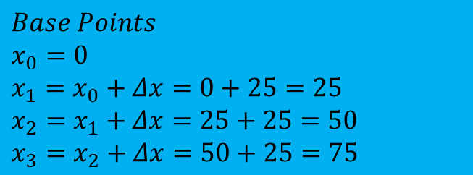
Beam Problem
To be determined
i=1 i=2 i=3 i=4
X=0 x=25 x=50 x=75
y
y₂=?
y₃=?
$$Base Points$$
$$x_{0}=0$$
$$x_{1}=x_{0}+Δx=0+25=25$$
$$x_{2}=x_{1}+Δx=25+25=50$$
$$x_{3}=x_{2}+Δx=50+25=75$$
y₁=0
y₄=0
0 25 50 75 x
x0 x1 x2 x3

Slide 3
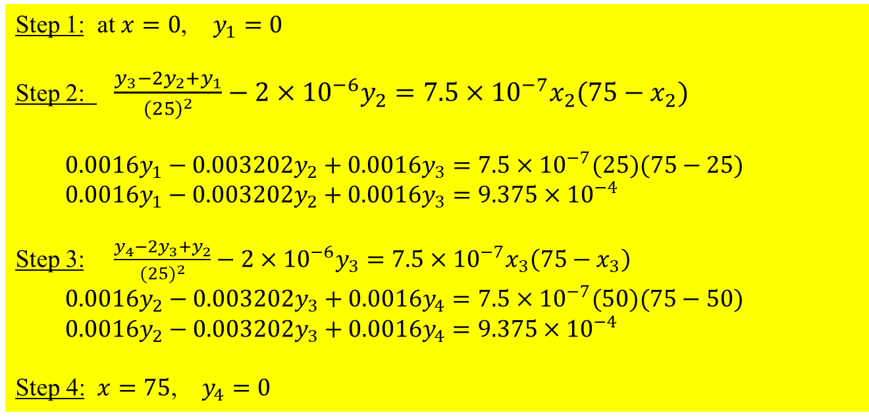
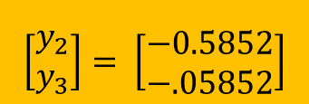

Beam Problem
Solution
Step 1: at $x=0$, $y_{1}=0$
Step 2: $\frac{y_{3}−2y_{2}+y_{1}}{(25)^{2}}−2×10^{−6}y_{2}=7.5×10^{−7}x_{2}(75−x_{2})$
$0.0016y_{1}−0.003202y_{2}+0.0016y_{3}=7.5×10^{−7}(25)(75−25)$
$0.0016y_{1}−0.003202y_{2}+0.0016y_{3}=9.375×10^{−4}$
Step 3: $\frac{y_{4}−2y_{3}+y_{2}}{(25)^{2}}−2×10^{−6}y_{3}=7.5×10^{−7}x_{3}\left(75−x_{3}\right)$
$$0.0016y_{2}−0.003202y_{3}+0.0016y_{4}=7.5×10^{−7}(50)(75−50)$$
$$0.0016y_{2}−0.003202y_{3}+0.0016y_{4}=9.375×10^{−4}$$
Step 4: $x=75$, $y_{4}=0$
$$\left[\begin{aligned}y_{2} \\ y_{3}\end{aligned}\right]= \left[\begin{aligned}−0.5852 \\ −.05852\end{aligned}\right]$$
$$y(50)=y(x_{2})≈y_{2}=−0.5852"$$

Slide 4
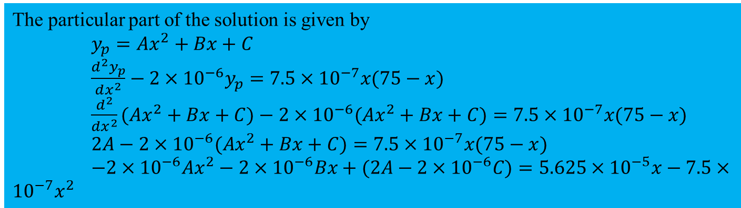
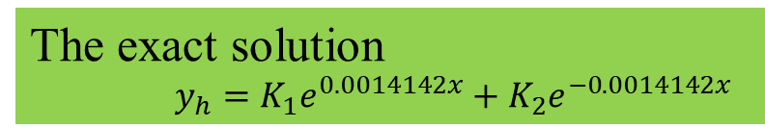

Beam Problem
The exact solution
$y_{h}=K_{1}e^{0.0014142x}+K_{2}e^{−0.0014142x}$
The particular part of the solution is given by
$y_{p}=Ax^{2}+Bx+C$
$\frac{d^{2}y_{p}}{dx^{2}}−2×10^{−6}y_{p}=7.5×10^{−7}x(75−x)$
$\frac{d^{2}}{dx^{2}}(Ax^{2}+Bx+C)−2×10^{−6}(Ax^{2}+Bx+C)=7.5×10^{−7}x(75−x)$
$2A−2×10^{−6}(Ax^{2}+Bx+C)=7.5×10^{−7}x(75−x)$
$−2×10^{−6}Ax^{2}−2×10^{−6}Bx+(2A−2×10^{−6}C)=5.625×10^{−5}x−7.5×10^{−7}x^{2}$
Solving the above equation gives
$A=0.375$, $B=−28.125$, $C=3.75×10^{5}$
$y_{p}=0.375x^{2}−28.125x+3.75×10^{5}$
$y=0.375x^{2}−28.125x+3.75×10^{5}+K_{1}e^{0.0014142x}+K_{2}e^{−0.0014142x}$
Applying the following boundary conditions
$y(x=0)=0$
$y(x=75)=0$
$$K_{1}+K_{2}=−3.75×10^{5}$$
$1.1119K_{1}+0.89937K_{2}=−3.75×10^{5}$
$\left[\begin{matrix}1 & 1 \\ 1.1119 & 0.89937\end{matrix}\right]\left[\begin{matrix}K_{1} \\ K_{2}\end{matrix}\right]=\left[\begin{matrix}−3.75×10^{5} \\ −3.75×10^{5}\end{matrix}\right]$
$\left[\begin{matrix}K_{1} \\ K_{2}\end{matrix}\right]=\left[\begin{matrix}−1.775656226×10^{5} \\ −1.974343774×10^{5}\end{matrix}\right]$

